Slide 1
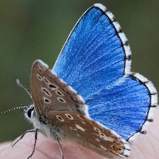

CLASIFICACIÓN DE MARIPOSAS

Slide 2
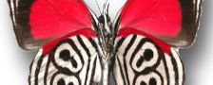

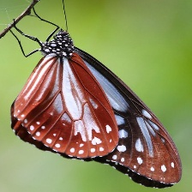
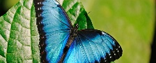

ELEMENTOS
TEST
TRAINING
VALID

Slide 3
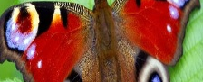
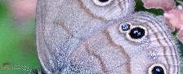
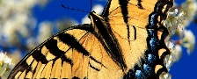
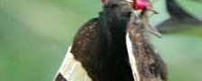
eSPECIES
+ 50 Especies Diferentes de mariposas
250 imágenes divididas en 50 subdirectorios con 5 imágenes de prueba por especie

Slide 4
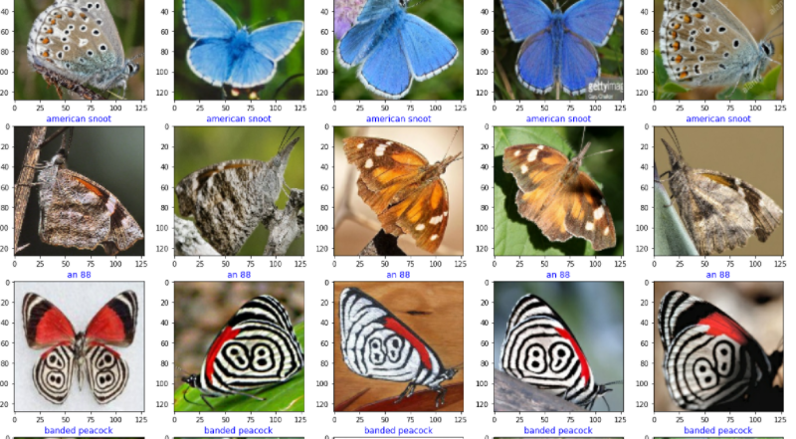
class_names=train_ds.class_names class_count=
(class_names) plt.figure(figsize=(20,20)) for images, labels in test_ds.take(1): for i in
(25): plt.subplot(5,5,i +1) img=images[i]/255 plt.title(class_names[labels[i]], color='blue', fontsize=12) plt.imshow(img) plt.show()

Slide 5
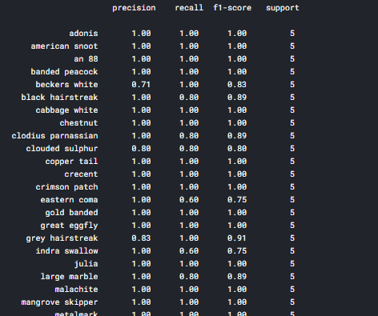
ypred=[] errors=0 count=0 preds=model.predict(test_ds, verbose=1) for i, p in
(preds): count +=1 index=np.argmax(p) klass=class_names[index] ypred.append(klass) if klass != ytrue[i]: errors +=1 acc= (count-errors)* 100/count msg=f'there were {count-errors} correct predictions in {count} tests for an accuracy of {acc:6.2f} % '
(msg) ypred=np.array(ypred) ytrue=np.array(ytrue) clr = classification_report(ytrue, ypred, target_names=class_names)
("Classification Report:\n----------------------\n", clr)

Slide 6
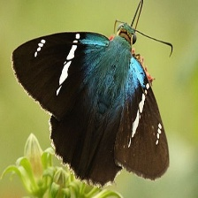
DATASET:
kaggle datasets download -d gpiosenka/butterfly-images40-species
GRACIAS

